Slide 1

STORE RESEARCH AND AREA SELECTION FOR INVESTING AND OPENING A NEW STORE

Slide 2





HELLO AND WELCOME TO MY PRESENTATION

Slide 3

IN THIS NOTEBOOK I AM GOING TO DEFINE THE BUSINESS PROBLEM OF SEARCHING THE DIFFERENT KIND OF VENUES IN THE STREETS OF ATHENS. WE WILL ALSO EXPLORE THE TRENDS IN THE CITY, FIND OUT WHICH TYPES OF SHOPS ARE POPULAR AND FIND THE ONES THAT ARE MOST OFTEN OBSERVED. IN THE END OF THE NOTEBOOK, GIVEN THE RESEARCH WE WILL DO, I WILL DISCUSS IN WHAT TYPE OF CATEGORY INVESTOR SHOULD FOCUS ON WHEN OPENING A NEW SHOP AND ALSO IF THE SHOP SHOULD BE A PART OF A BUSINESS CHAIN OR A STAND-ALONE SHOP

Slide 4


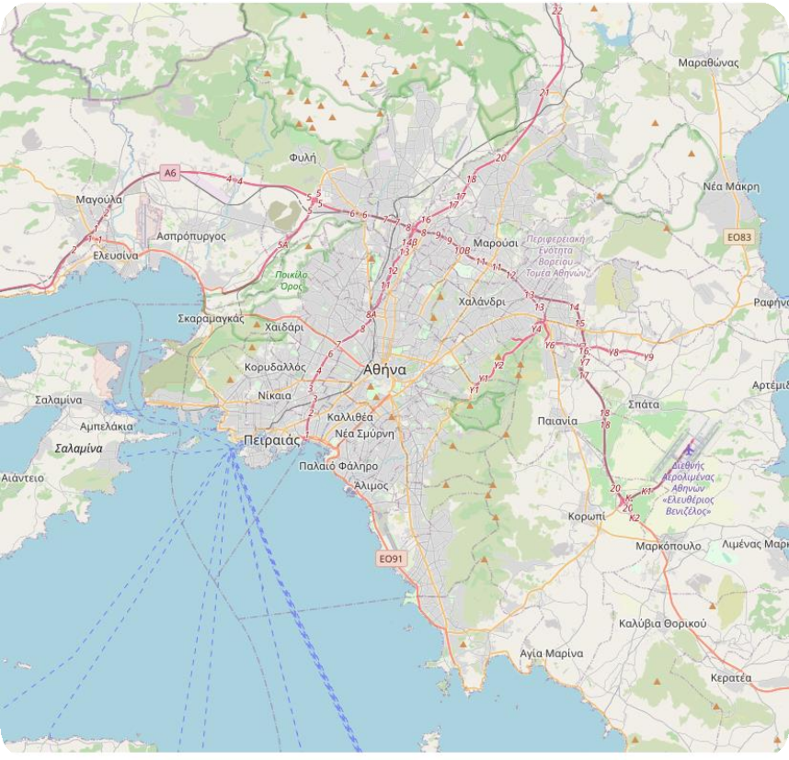
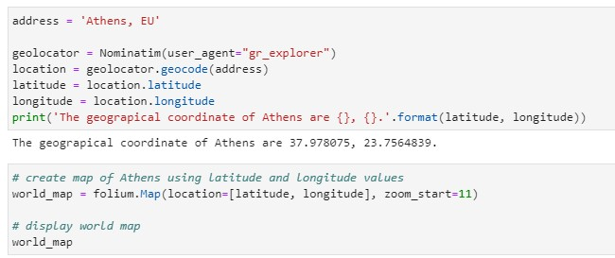
FIRST OF ALL WE ARE GOING TO CREATE A MAP OF GREECE AND TAKE A LOOK AT THE AREAS WE ARE GOING TO WORK ON

Slide 5




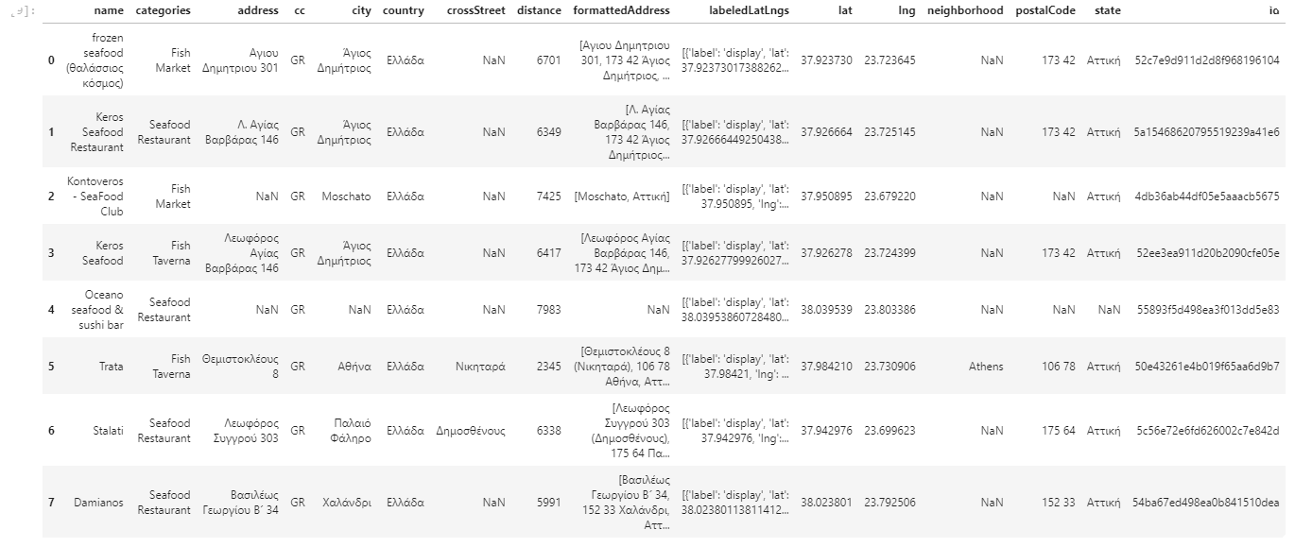
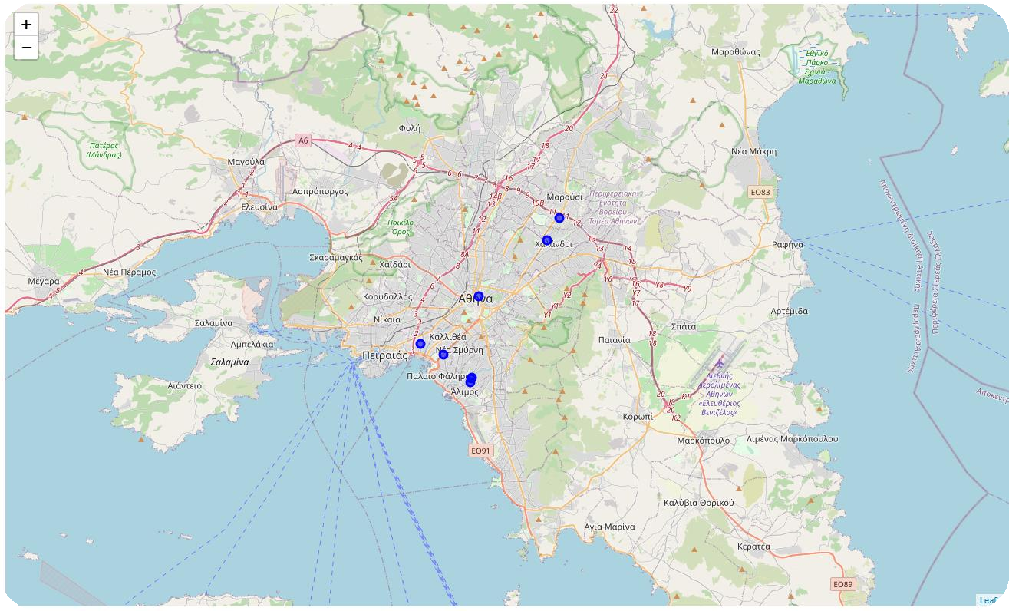
LET'S SEARCH HOW MANY SEAFOOD PLACES APPEAR ON OUR MAP
As it seems Seafood places are not very popular in Athens so we will explore the area to get a taste of what shops are there

Slide 6
EXPLORING THE VENUES OF ATHENS

Slide 7
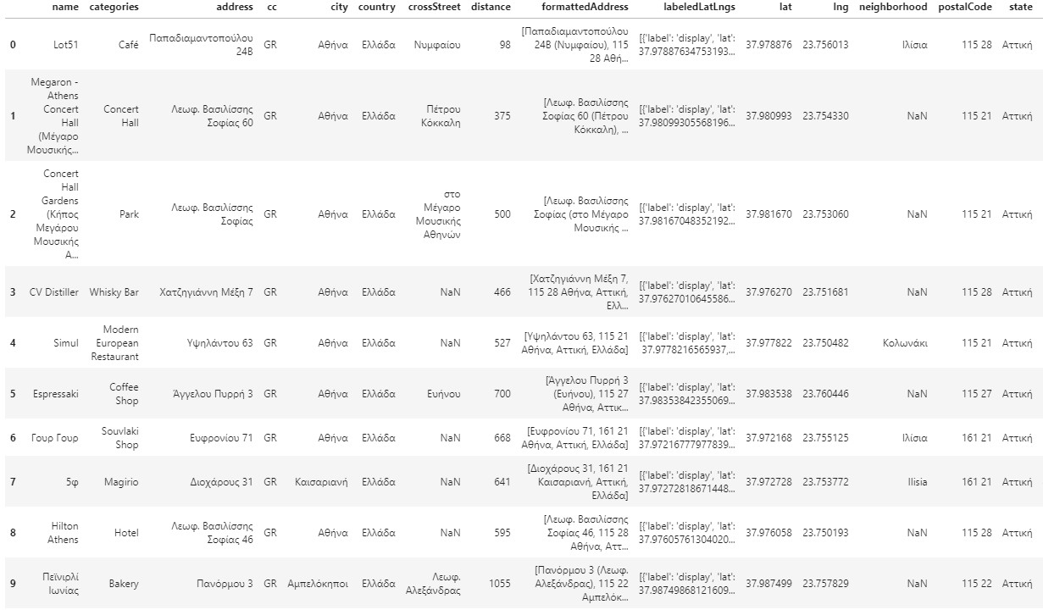
WE WILL ACQUIRE A NEW LINK FROM FOURSQUARE TO EXPLORE THE SHOPS AND WE WILL CONVERT IT INTO A DATA FRAME

Slide 8





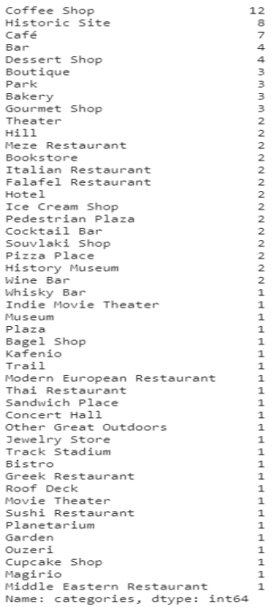
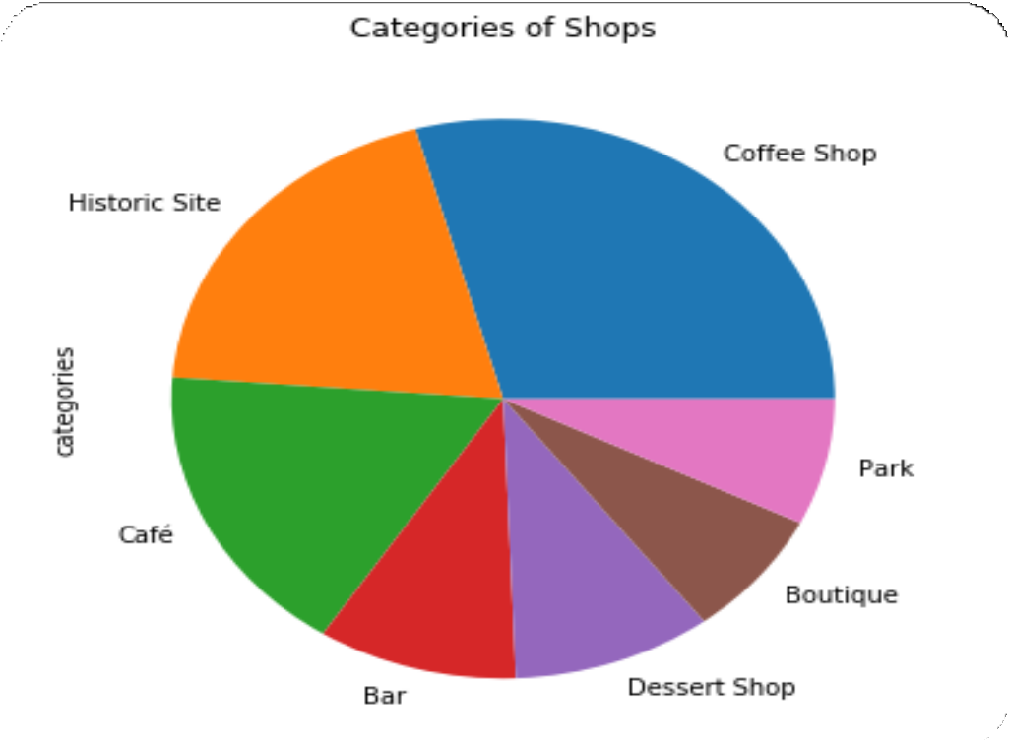
AS WE CAN SEE, THE TOP RESULT IS COFFEE SHOPS SO WE WILL COUNT THE VALUES AND PLOT THE TOP 7 JUST TO BE SURE

Slide 9
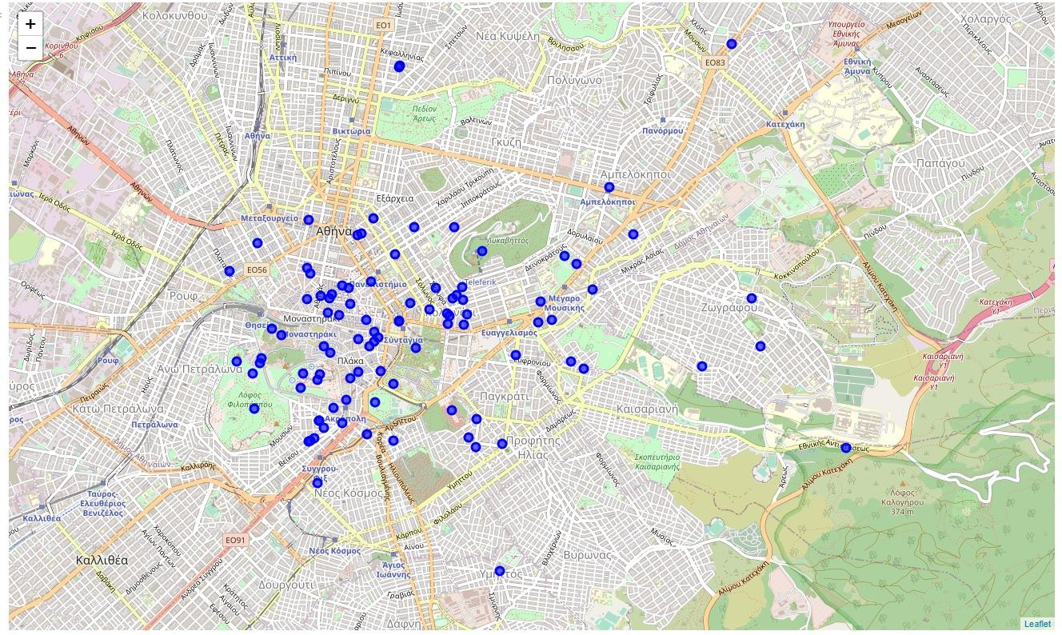
WE WILL GENERATE OUR MAP AGAIN WITH THE DIFFERENT SHOPS ABOVE MARKED IN BLUE

Slide 10
THINGS START TO GET INTERESTING. LET'S HAVE A LOOK ON TRENDING SHOPS AT THIS TIME. NOW,DEPENDING ON WHEN WE RUN THE BELOW CODE,WE MIGHT GET DIFFERENT SHOPS SINCE THE SHOPS WITH THE HIGHEST FOOT TRAFFIC ARE FETCHED LIVE
Well then..

Slide 11
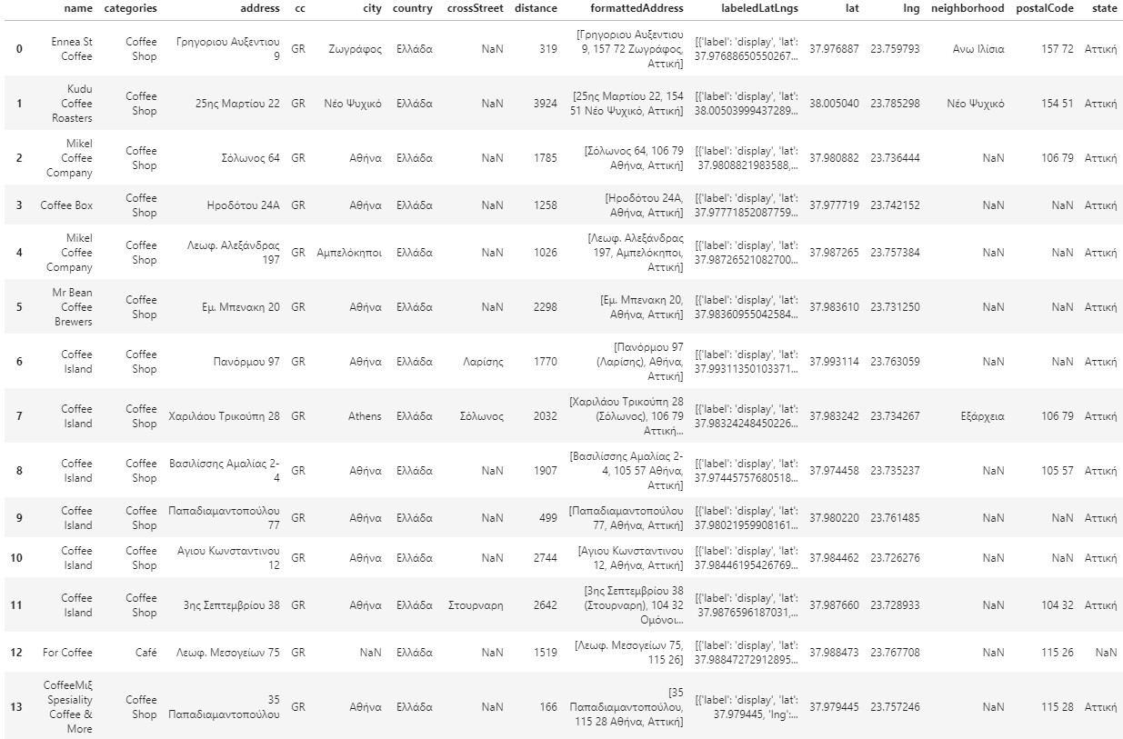
NOW THERE AREN'T ANY TRENDING SHOPS AT THE MOMENT AND SO WE'LL FOCUS ON THE COFFEE SHOPS OF ATHENS

Slide 12
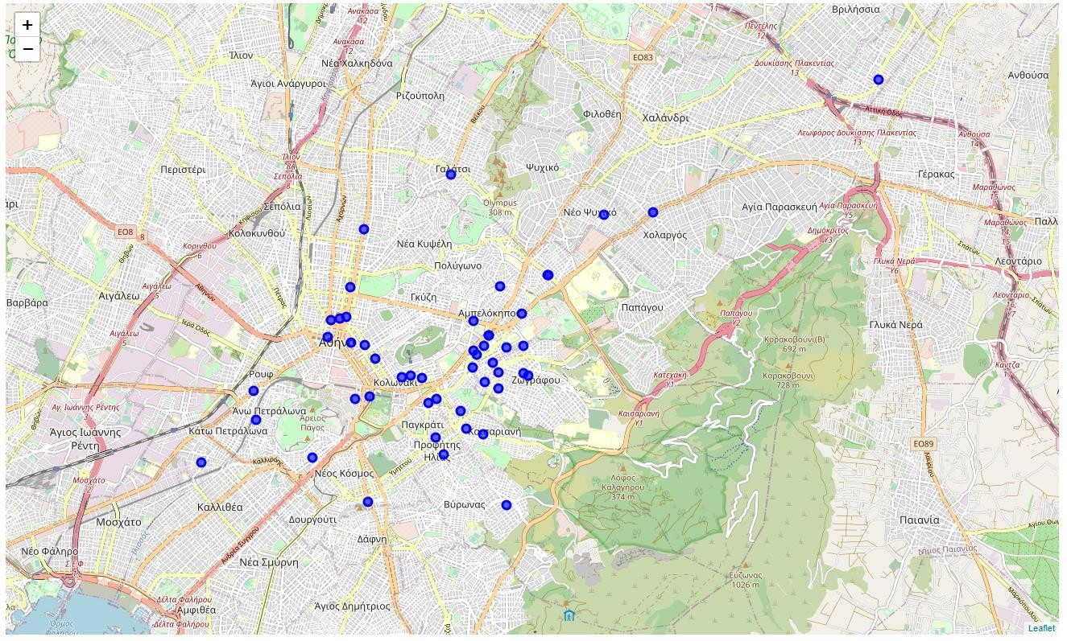
AT LAST LET'S VISUALIZE THESE ITEMS ON THE MAP AROUND OUR LOCATION

Slide 13
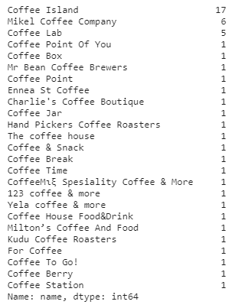
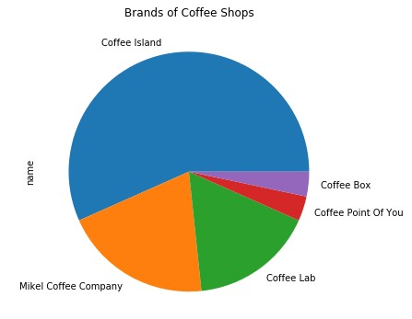
WE'LL COUNT THE DIFFERENT COFFEE SHOPS TO GET AN IDEA OF WHAT IS POPULAR IN OUR AREA

Slide 14
CONCLUSION
The vast majority of coffee shops consists of Coffee island then Mikel Coffee Company and Coffee Lab. So, if we want to invest and open a new shop it would be best to open a Coffee Island or a Mikel Coffee Company Coffee shop. Also, if we examine the map above, a great place to start would be near the Economic University of Athens or the National Technical University of Athens where there is heavy foot traffic especially from the students who attend the lectures

Slide 15
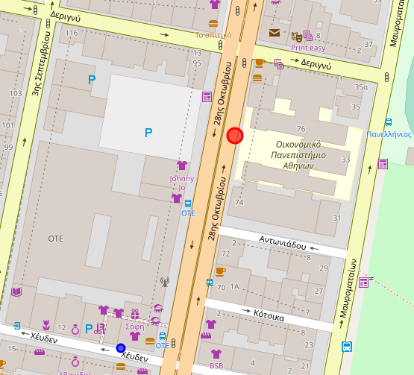
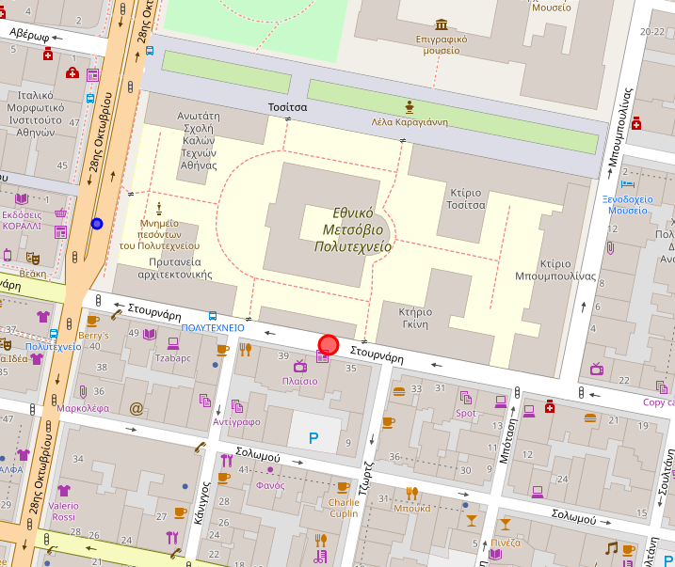

Slide 16
THANK YOU FOR YOUR TIME
This notebook was created by Nikolas Vitsentzatos

